Slide 1
Grade: 9th (first class of Lyceum) Subject of Mathematics: Euclidean Geometry Lecture / Lesson plan
A few words about Euclid and his Elements
Euclid (about 300 BC, Alexandria, Egypt)
The most prominent mathematician of Greco-Roman antiquity,
best known for his treatise on geometry, the Elements (13 Books).
Euclid understood that building a logical and rigorous geometry (and mathematics)
depends on the foundation.
Euclid began in Book I with 23 definitions,
5 unproved assumptions that Euclid called postulates (now known as axioms),
and 5 further unproved assumptions that he called common notions.

Slide 2
Euclid's axioms
1 | Given two points there is one straight line that joins them.
2 | A straight-line segment can be prolonged indefinitely.
3 | A circle can be constructed when a point for its center and a distance for its radius are given.
4 | All right angles are equal.
5 | If a straight line falling on two straight lines makes the interior angles on the same side less than two right angles, the two straight lines, if produced indefinitely, meet on that side on which the angles are less than the two right angles.
Euclid’s common notions
6 | Things equal to the same thing are equal.
7 | If equals are added to equals, the wholes are equal.
8 | If equals are subtracted from equals, the remainders are equal.
9 | Things that coincide with one another are equal.
10 | The whole is greater than a part.

Slide 3
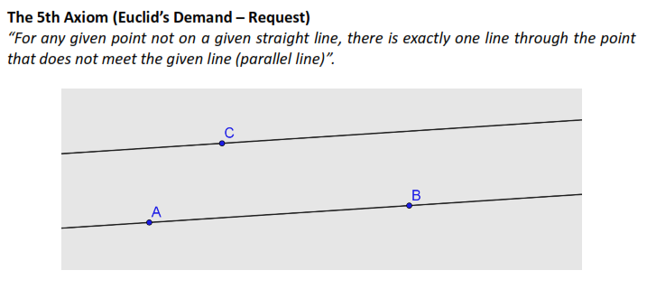

Slide 8
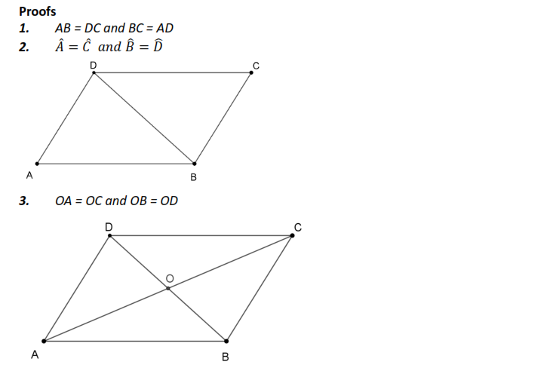
We can compare triangles
and prove the properties
using the equality…

Slide 10
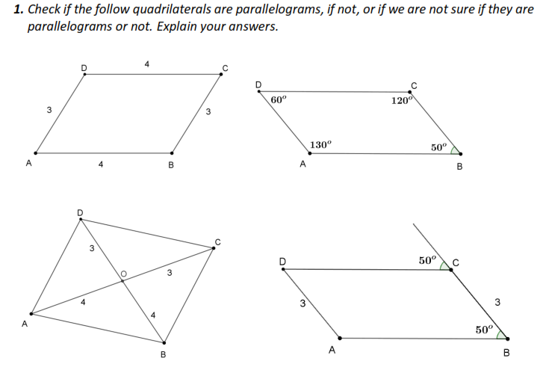

Slide 11
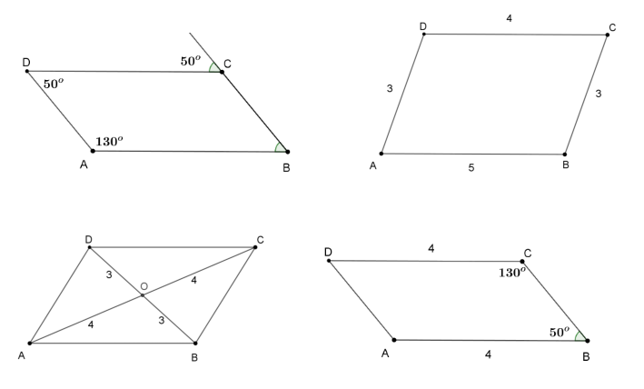

Slide 12
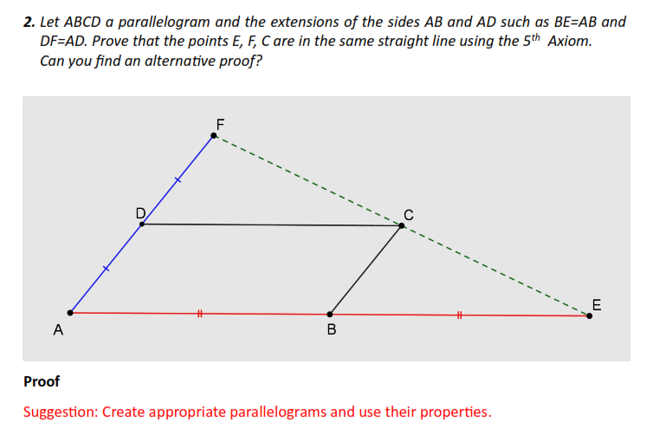

Slide 16
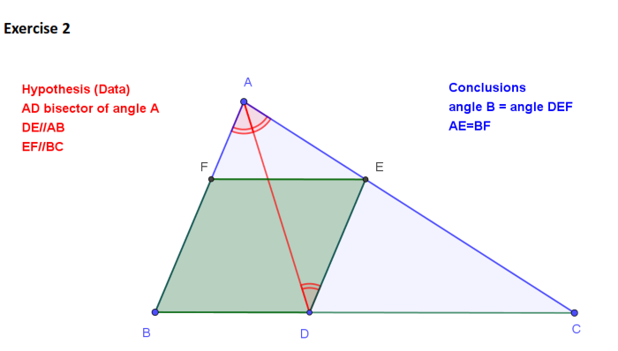

Slide 17
Exercise 3

